Slide 1
Capstone 1
Ryne schultz

Slide 2
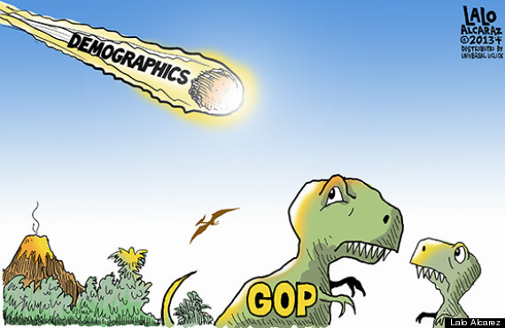

Slide 3
PART I: DATA WRANGLING

Slide 4
Problem Statement
Over the past 50 years demographic and socioeconomic trends have drastically changed the United States.
This has driven political change.
These changes have upended the traditional political coalitions and has made political predictions more difficult (e.g. the 2016 election).
These changes are of particular importance to political campaigns.
An improved prediction methodology will help political parties avoid wasting resources.

Slide 5
Data Description
The Census Bureau’s “My Congressional District” tool lets you browse (and download) demographic, socioeconomic, and business data corresponding to each of the country’s 435 congressional districts (plus D.C.).
Political scientist Ella Foster-Molina has compiled a historical dataset containing similar information for the period from 1972 to 2014.
This dataset contains details about each district’s representatives – such as their personal characteristics, the committees they served on, and the number of bills they sponsored.

Slide 6
Removing Irrelevant Data
Since the goal of our model is to predict district party affiliation using demographic and socioeconomic data, we removed all non-demographic and non-socioeconomic features.
After removing these features, we are left with the following list of features that will help us train and develop our model:
recentArrivalPrcnt - percent of the district that recently moved into the district from another county or state.
totalPopBirthPlace - total population used for measuring mobility and/or nativity.
prcntForiegnBorn - percent of the district that was born in a foreign country.
10 socioeconomic features that include % of population earning below $10k, over $10k, over $15k, etc. all the way up to $200k.
prcntUnemp - percent of the district’s population that is unemployed but still in the labor force.
prcntBA - percent of the district with a bachelor’s degree or higher.
prcntHS - percent of the district with a high school degree or higher.
prcntAsian - percent of the district that is Asian.
prcntBlack - percent of the district that is black, including black Hispanics.
prcntHisp - percent of the district that is Hispanic, both white and black.
prcntWhiteAll - percent of the district that is white, including whit Hispanics.
gini - inequality index estimated from the percent of the population in each income bracket.

Slide 7
Dealing with Missing Values
Once we removed irrelevant features from our dataset, there were very few rows that had any missing values.
Those rows that did have missing data were simply removed from the data.
The number of rows only declined from 9,312 to 9,298.

Slide 8
Processing the Dependent Variable
The goal of our analysis is to predict – given a district’s demographic and socioeconomic characteristics – whether that district is more likely to vote Democrat or Republican.
This binary type of classification lends itself well to Logistic Regression.
In logistic regression, the probabilities describing the possible outcomes of a single trial are modeled using the log-odds (i.e. the logarithm of the odds) for values labeled “1”, using a linear combination of one or more independent variables (i.e. our independent variables).
Logistic regression uses a common "S" (or “sigmoid”) curve to model a binary dependent variable. The resulting probability of the value labeled "1" can vary between 0 and 1, with the model rounding these values to determine categorization.
As such, our dependent variable must be converted to a numerical binary – represented by either a 0 (for Republican) or 1 (for Democrat).
We can accomplish this by applying one-hot encoding, a process by which we convert text-based features into numerical, binary values – represented as “1” or “0” – “True” or “False”.

Slide 9
PART Ii: Exploratory Data Analysis

Slide 10
Graphical Analysis
The data is organized by Congress (specifically, the 93rd through 113th Congresses) so it makes sense to visualize the data as a time-series plot, with Congressional Number on the x-axis and the various independent variables on the y-axis.
A time-series plot allows us to see demographic and socioeconomic differences between Democratic and Republican districts, plotted over time.
Variables that exhibit persistent party, over time, are likely to be the most significant variables in explaining the variation in party outcomes.

Slide 11
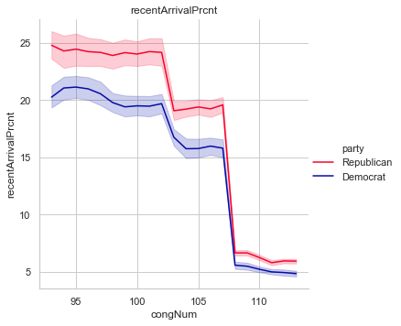
Plot #1 – recentArrivalPrcnt
Key Takeaways
There has been a distinct reduction in the mobility of Americans – in both Democratic and Republican districts.
Mobility has declined less in Republican districts.
We expect that districts with higher recent arrival percentages will be more likely to vote Republican.

Slide 12
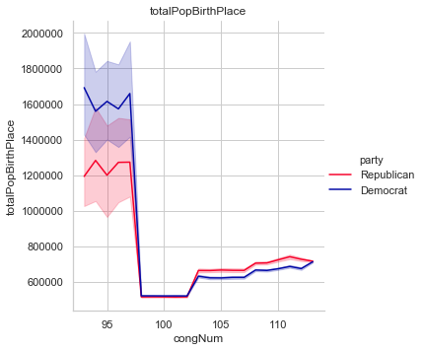
Plot #2 – totalPopBirthPlace
Key Takeaways
There does not appear to large, persistent differences between Republican and Democratic districts when it comes to district population.
It appears that Republican districts have had larger districts populations, on average, in more recent congresses.
It’s difficult to determine, purely based on this plot, how this feature will effect the model.

Slide 13
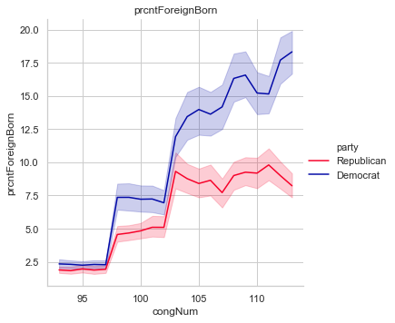
Plot #3 – prcntForeignBorn
Key Takeaways
The percent of district populations born in a foreign country has increased in both Democratic and Republican districts.
However, this trend is much more pronounced in Democratic districts.
We expect that districts with higher foreign-born population percentages will be more likely to vote Democratic.

Slide 14
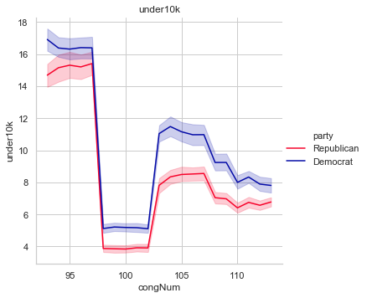
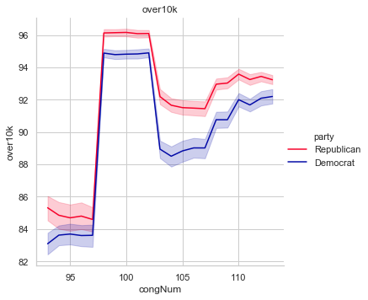
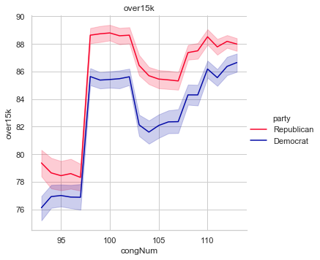
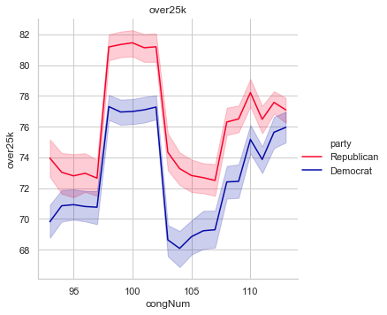
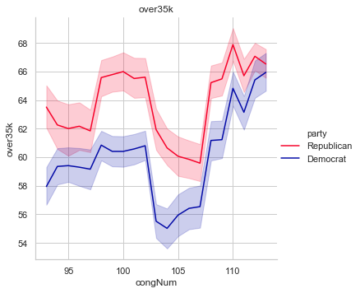
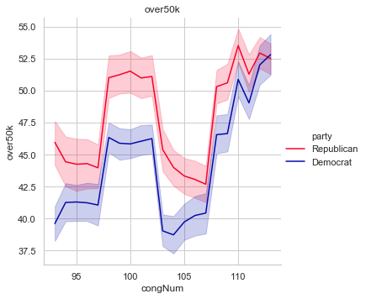
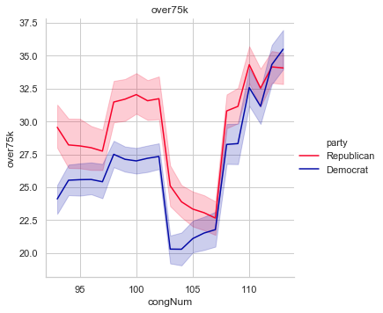
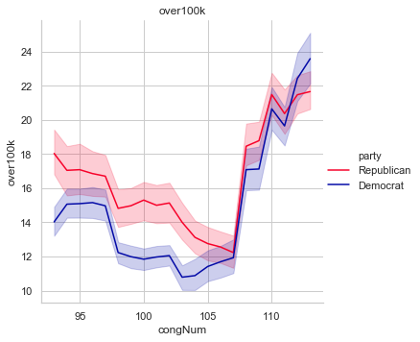
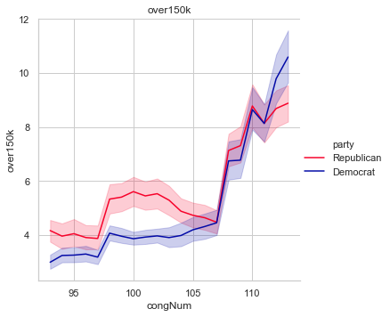
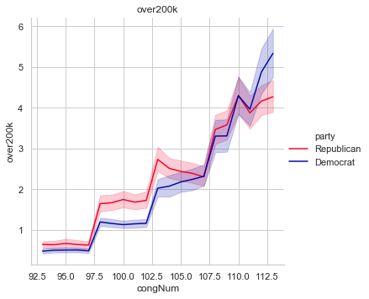
Plot #4 – 10 Socioeconomic variables
Key Takeaways
Regardless of the socioeconomic breakdown, Democratic districts have, on average, been poorer than Republican districts.
This difference becomes less pronounced as we move up the socioeconomic ladder.
We expect that districts with low incomes and high incomes – relative to the average – to vote Democratic, while more middle class districts are likely to vote Republican

Slide 15
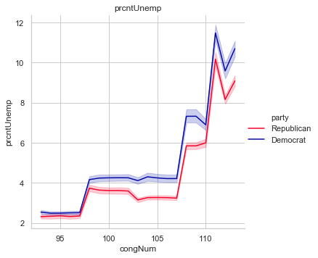
Plot #5 – prcntUnemp
Key Takeaways
The structural unemployment rates in both Democratic and Republican districts have increased. This is likely due to higher retirement rates.
It appears that unemployment rates have been persistently higher in Democratic districts.
Therefore, we expect districts with higher unemployment rates to more likely vote Democratic.

Slide 16
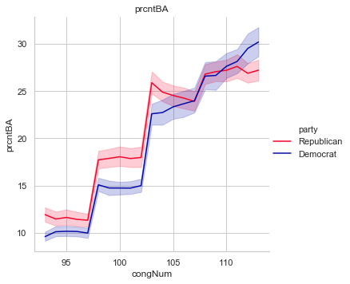
Plot #6 – prcntBA
Key Takeaways
Historically, Republican districts have had higher college graduation rates.
However, this trend has reversed. Democratic districts now have higher college graduation rates.
We should expect that districts with higher college graduation rates to more likely vote Democratic.

Slide 17
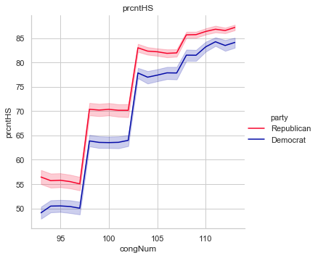
Plot #7 – prcntHS
Key Takeaways
High school graduation rates have consistently risen in both Democratic and Republican districts.
However, Republican districts have had persistently higher rates of high school graduation.
Therefore, we expect that districts with higher high school graduation rate to more likely vote Republican.

Slide 18
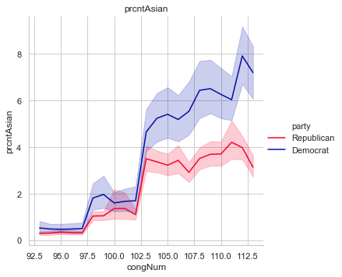
Plot #8 – prcntAsian
Key Takeaways
The Asian population as a percent of total district population has risen in both Democratic and Republican districts.
However, this trend is more pronounced in Democratic districts.
Therefore, we expect districts with a higher percentage Asian populations to more likely vote Democratic.

Slide 19
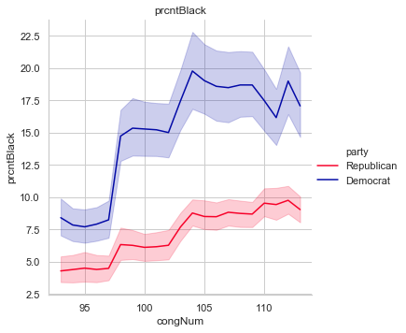
Plot #9 – prcntBlack
Key Takeaways
The percentage black population of both Democratic and Republican districts has risen.
However, this rise has been far more pronounced in Democratic districts.
Therefore, we expect that districts with higher percentage black populations to more likely vote Democratic.

Slide 20
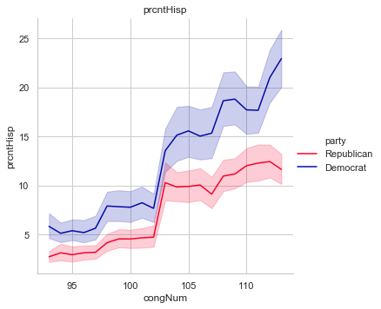
Plot #10 – prcntHisp
Key Takeaways
The percentage Hispanic population of both Democratic and Republican districts has risen dramatically.
However, this rise has been considerably more pronounced in Democratic districts.
Therefore, we expect that districts with higher percentage Hispanic populations will more likely vote Democratic.

Slide 21
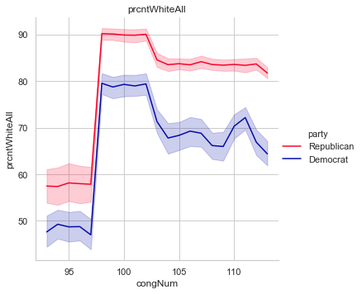
Plot #11 – prcntWhiteAll
Key Takeaways
Both Democratic and Republican districts initially saw a spike in their percentage white populations, but have seen their percentage white populations stabilize.
However, the percentage white population has been consistently higher in Republican districts.
Therefore, we expect that districts with higher percentage white populations to more likely vote Republican

Slide 22
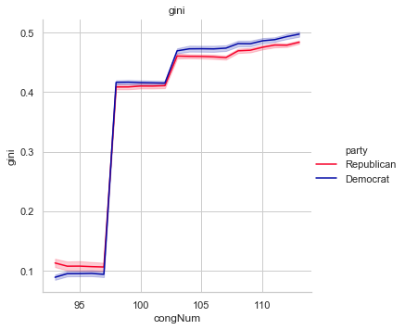
Plot #12 – gini
Key Takeaways
Inequality has increased in both Democratic and Republican districts.
It is difficult to discern a persistent difference between Democratic and Republican districts.
Therefore, it is difficult to predict how inequality (as measured by the gini coefficient) will affect our model.

Slide 23
Variable Significance
An initial test for significance suggested that over75k, over150k, over200k, and prcntUnemp are all statistically insignificant in explaining the variation in the dependent variable at the 5% confidence level (i.e. a p-value less than 0.05)
Fortunately, after removing these features from the data, the remaining features remain significant.
Thus, of the original 21 features tested, only 16 were determined to be statistically significant (again, determined by a p-value less than 0.05).

Slide 24
Feature Correlation
Features that are highly correlated will hinder the accuracy of our model as our model will find it difficult to discern the origination of an effect on the dependent variable.
Therefore we must remove highly correlated dependent variables.
There is a great deal of correlation amongst our various socioeconomic variables (i.e. under10k, over10k, over15k, etc.). In fact, given these high correlations it makes the most sense to – at the very least – remove either under10k or over10k since they are simply the inverse of one another.
We have opted to remove under10k. Thus we now have 15 relevant and significant features to utilize in our logistic regression model.

Slide 25
PART Iii: the model

Slide 26
Prepping the Data
The first step in running or model is to prep our data by establishing our X and y values – our independent and dependent variables in the model.
The dependent variable (y) is our column party_Democrat.
Our independent variables (X) are the 15 relevant and significant variables we determined during exploratory data analysis.
After establishing our X and y variables, we then proceed to split the data into a training set and test set (using a 70/30 split), shuffling the data.

Slide 27
Tuning the Model
When we train a model such as a logistic regression, we must make tuning decisions that give us the best fit to the training data.
However we also want to avoid overfitting.
In our Logistic Regression model we have 4 important parameters to tune:
C – equal to 1/lambda, or the inverse of the regularization strength.
K – number of folds used in cross-validation.
class_weight – the weights associated with the classes of our dependent variable.
Solver – the optimization algorithm to use in our model.

Slide 28
Selecting the Solver
Scikit-learn provides us 5 solvers to choose from:
liblinear
newton-cg
lbfgs
sag
saga
Each algorithm has its respective strengths and weaknesses:
For small datasets, liblinear is a good choice, but is limited to one-versus-rest schemes
sag and saga are faster for larger data sets
newton-cg, lbfgs and sag are only able to handle L2 penalty
liblinear and saga can handle L1 as well as L2 penalty
For multiclass problems, only newton-cg, sag, saga and lbfgs are able to handle multinomial loss

Slide 29
Selecting the Solver (cont.)
Perhaps the most important aspect to consider when choosing a solver is determining the available error penalties – i.e. L1 or L2.
These penalties are two different methods of accounting for error in our model.
A regression model that uses the L1 penalty is using Lasso Regression, whereas a model using an L2 penalty is using Ridge Regression.
Lasso Regression (which stands for Least Absolute Shrinkage and Selection Operator) adds the absolute value magnitude of the coefficient as a penalty term to the loss function
Ridge regression adds the squared magnitude of the coefficient as a penalty term to the loss function
The main difference between these techniques is that Lasso Regression shrinks the less important features’ coefficients to zero.
We will test 5 combinations of solver and penalty to determine the best combination to use in our model.

Slide 30
Selecting the Solver (cont.)
After running all 5 solvers, we arrive at the following cross-validated accuracy scores (with standard deviations provided in parentheses):
liblinear (L1): 0.61 (+/- 0.07)
liblinear (L2): 0.63 (+/- 0.08)
lbfgs: 0.59 (+/- 0.07)
newton-cg: 0.61 (+/- 0.10)
sag: 0.55 (+/- 0.00)
saga (L1): 0.55 (+/- 0.00)
saga (L2): 0.55 (+/- 0.00)
One clear winner stands out: “liblinear (L2)”. This solver/penalty combination both maximizes its mean accuracy score and minimizes its standard deviation.
The “liblinear” solver implements a logistic regression model using a coordinate descent algorithm.

Slide 31
PART IV: Analyzing the results

Slide 32
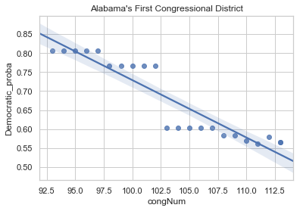
Analyzing District Probabilities Over Time
The first step in our analysis to look at the predicted probabilities for specific districts over time.
For example, let us consider Alabama's First and Seventh Congressional Districts.
Alabama’s First Congressional District incorporates southern Alabama – including the greater Mobile and Pensacola areas

Slide 33
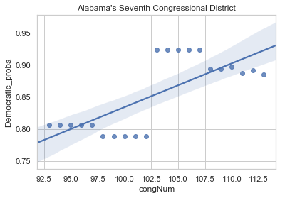
Analyzing District Probabilities Over Time (cont.)
Alabama’s Seventh Congressional District incorporates parts of Birmingham, Montgomery, and Selma – areas that comprise the heart of Alabama’s “Black Belt”.
Our model capable of picking up on these distinctions and trends and successfully categorized Alabama’s First Congressional District as Republican and Alabama’s Seventh Congressional District as Democratic.

Slide 34
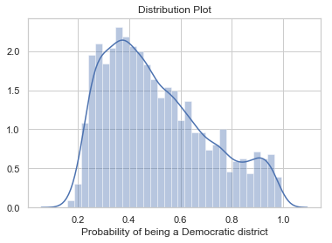
Plotting the Probability Distribution
One of the main benefits of using a Logistic Regression is that – unlike other categorization methods – logistic regression provides a level of confidence in its prediction in the form of a probability.
This probability denotes the probability of a given observation being categorized as a 1, given that observation’s independent variable values.
A strong model would be bi-modal.
A poor model’s distribution would be concentrated around the middle.
When we plot the distribution, we see that it is right-skewed, with a large congregation of predicted probabilities around the center, largely around 40%

Slide 35
Using k-means to Categorize District Probabilities
Now that we have a distribution of probabilities, we can analyze this distribution at a more granular level by applying yet another categorization model to the probabilities – K-means clustering.
K-means clustering is one of the simplest and most popular unsupervised machine learning algorithms in use today.
Unsupervised algorithms – in contrast to supervised algorithms like Logistic Regression – make inferences from datasets using only input vectors without referring to known, or labelled, outcomes.
The objective of K-means is straightforward: group similar data points together and discover underlying patterns.
To achieve this objective, K-means looks for a fixed number of clusters in a dataset – allocating each data point to the nearest cluster, while at the same time keeping the centroids (the center of the cluster) as small as possible.
Initially, these centroids are randomly assigned. However, the algorithm performs iterative calculations to optimize the positions of the centroids – seeking to continually reduce the in-cluster sum of squares.

Slide 36
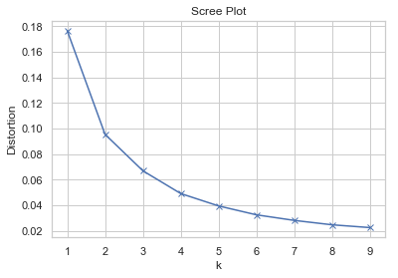
Using k-means to Categorize District Probabilities (cont.)
We can plot the in-cluster sum of squares against k to determine the optimal k value to apply to our K-means clustering model – a graph known as a Scree Plot.
The optimal K value is determined by finding the “elbow” of the graph – i.e. the point or region in the graph where the distortion (i.e. the in-cluster sum of squares) initially falls precipitously and then begins to flatten as K increases.
The “elbow” of our graph appears to be around three, meaning the optimal K value is 3 clusters.
This makes intuitive sense since, when we consider our distribution of predicted probabilities, we have three main categories of probability – solidly Republican (signified by those probabilities nearest to 0), solidly Democratic (signified by those probabilities nearest to 1), and swing (signified by those probabilities nearest to 0.5).

Slide 37
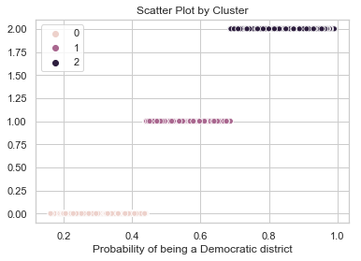
Plotting the Clusters
The model has successfully clustered the model into three categories.
These categories line up well with our intuition regarding solidly Republican districts, swing districts, and solidly Democratic districts.
Cluster 0 aligns with the solidly Republican districts.
Cluster 1 aligns with the swing districts.
Cluster 2 aligns with the solidly Democratic districts.

Slide 38
Analyzing the Clusters
After setting K to 3 and fitting the K-means model to our predicted probabilities, we can now assign each observation a cluster value, signifying solidly Republican districts, solidly Democratic districts, and swing districts and analyze each cluster individually:
Our solidly Republican cluster (cluster 0) has a mean Democratic_proba value of 0.331032 (+/- 0.064201), a minimum predicted probability of 0.161027, a maximum predicted probability of 0.439838, and comprises ~45% of our predicted probabilities.
Our swing cluster (cluster 1) has a mean Democratic_proba value of 0.548778 (+/- 0.070527), a minimum predicted probability of 0.440226, a maximum predicted probability of 0.687366, and comprises ~36% of our predicted probabilities.
Our solidly Democratic cluster (cluster 2) has a mean Democratic_proba value of 0.826023 (+/- 0.087531), a minimum predicted probability of 0.687590, a maximum predicted probability of 0.990862, and comprises ~19% of our predicted probabilities.
When we analyze our clusters by unique district, we find the following breakdown:
Number of Republican Districts: 239
Number of Swing Districts: 121
Number of Democratic Districts: 76

Slide 39
Analyzing Swing District Trends
Given our ability to analyze probability trends we can now analyze swing district specific trends.
We split the data by designating those swing districts with a positively sloped trend line (i.e. a slope greater than 0) as Democratic.
Inversely, we designated those swing districts with a negatively sloped trend line (i.e. a slope less than or equal to 0) as Republican.
After performing this split process, we arrive at the following results:
Number of Democratic Trending Swing Districts: 29
Number of Republican Trending Swing Districts: 92
If we then add these two figures to our solidly Democratic and solidly Republican figures we arrive at the following results:
Total Democratic Districts: 105
Total Republican Districts: 331

Slide 40
Analyzing National Trends
Do we see these same trends on the national level?
To answer this question, we determined a lead time of 10 congresses (roughly 20 years into the future).
We then looked at national average trends and carried them out to the 123rd Congress using a simple straight-line estimate.
Most of the straight-line estimates were reasonable; however, several were not, and so manual estimates had to be calculated.

Slide 41
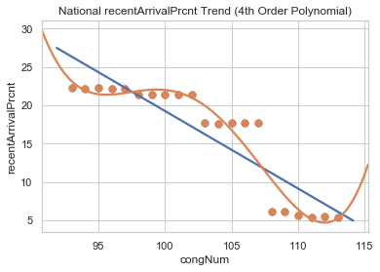
Manual Estimate Calculation #1 - recentArrivalPrcnt
In the case of recentArrivalPrcent we set the prediction equal to 5%, assuming the average recent arrival percentage will stabilize.
This estimate is predicated on a clear declining trend. However, it is impossible for the recentArrivalPrcnt to be negative and it is unlikely to fall to 0%
Therefore, we assume the declining trend to plateau at the 5% level.

Slide 42
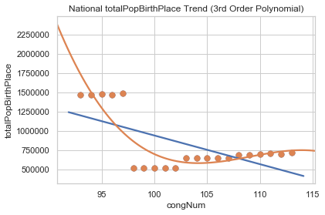
Manual Estimate Calculation #2 - totalpopbirthplace
For totalPopBirthPlace we set the prediction equal to 750,000
This assumes that the average total native-born population of a district stabilizes around 750,000 people.
This is predicated on a clear declining trend. However, the population is unlikely to continue declining.
Therefore, we assume the trend plateaus at 750,000 people.

Slide 43
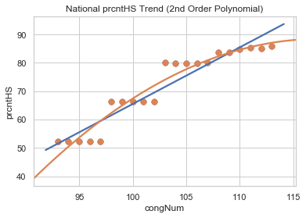
Manual Estimate Calculation #3 - prcntHS
It is obviously unreasonable to assume that high school graduation rates would exceed 100%.
Therefore, we set prcntHS equal to 90%, assuming the national average high school graduation rate will top out around the 90% level.

Slide 44
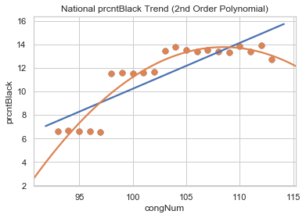
Manual Estimate Calculation #4 - prcntBlack
The national average percentage of black Americans appears to have peaked during the 105th Congress.
Therefore, we assume that the national average percentage black population will decline slightly and stabilize around 12%.

Slide 45
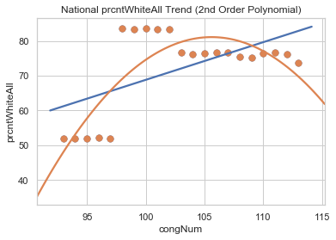
Manual Estimate Calculation #5 - prcntWhiteAll
For prcntWhiteAll, we simply backed into the predicted figure by subtracting the predicted Asian, Hispanic, and Black populations from 100%, arriving at a predicted national average percentage white population of ~52%.

Slide 46
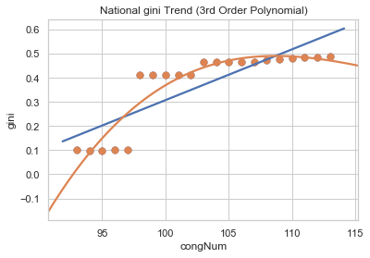
Manual Estimate Calculation #6 - gini
For gini, we assumed that the near-term average of around 0.5 would hold going forward.

Slide 47
National Trend Results (10 Congress Lead)
We then took these corrected predictions and plugged them into our original logistic regression model to determine a hypothetical, national predicted probability.
Finally, we plugged this predicted probability into our K-means model to assign the predicted probability to a cluster.
The following are the results of this process:
Probability Republican: 0.36770091129890736
Probability Democratic: 0.6322990887010926
Cluster Prediction: 1
Prediction: Swing

Slide 48
National Trend Results (20 Congress Lead)
To determine if the country is Democratic or Republican trending, we simply extended out our analysis to the 133rd Congress by changing our lead time to 20 from 10.
The following are the results:
Probability Republican: 0.2979208983740722
Probability Democratic: 0.7020791016259278
Cluster Prediction: 2
Prediction: Solid Democratic
By extending our predictions further out into the future we can see a larger national trend – namely, a country that is becoming more Democratic.

Slide 49
PART V: Conclusions

Slide 50
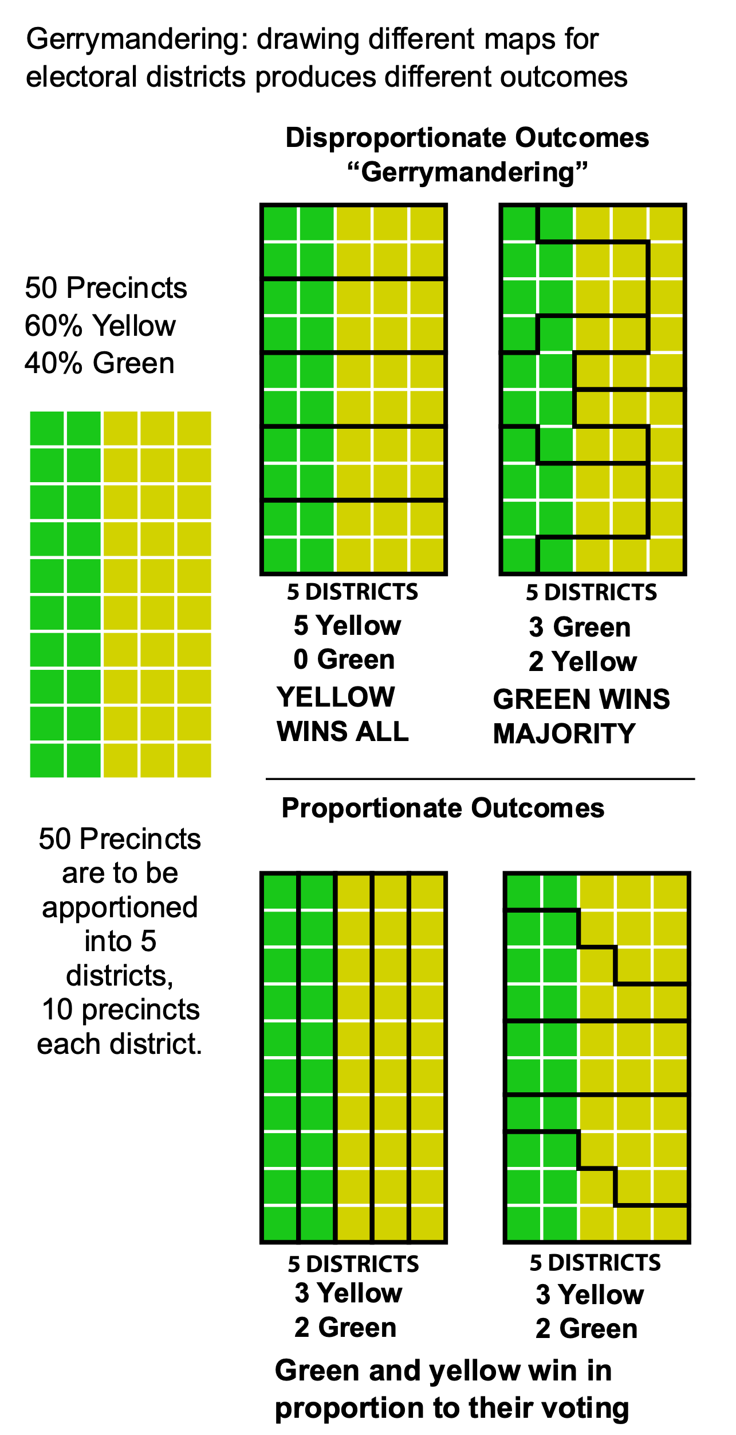
Redistricting
These results are, initially, quite confusing: though national trends point to a more Democratic nation, the individual district level demographics give Republican a definitive advantage.
What’s going on here? Aren’t these trends mutually exclusive?
We can have national trends pointing towards a more diverse – and be extension more Democratic – nation, while at the same time having Congressional trends that continue to favor Republicans. How?
Republicans have exploited this ambiguity in recent years by concentrating their efforts on getting Republicans elected to state legislatures, where these legislators would then draw the district maps to favor Congressional Republican incumbents – a process known as “Gerrymandering”.
The result are district maps (and by extension district demographics) that do not reflect national realities.

